Slide 1


Team 50: Remote Biometric System
Bi-Weekly Update 3 Simon Becker
Andrew-Joseph Nicolas
Lance Pagaduan
Harin Sankar Sponsor: Dr. Steven Wright TA: Hailey Ward
Notes:
Michelle

Slide 2
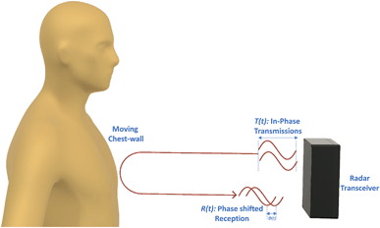
Contactless Cardiac Gating
Extensive and uncomfortable prep can be necessary
MRI Patient throughput can be improved
32% of patients think they wait too long for MRIs¹
Vasireddy, Rakesh & Roth, Corinne & Mathis, Johannes & Goette, Josef & Jacomet, Marcel & Vogt, Andreas. (2018). K-band Doppler radar for contact-less overnight sleep marker assessment: a pilot validation study. Journal of Clinical Monitoring and Computing. 32. 10.1007/s10877-017-0060-9.
Dostál, M., Jurasová, K., Keřkovský, M. et al. What factors affect a patient’s subjective perception of MRI examination. Sci Rep 14, 22731 (2024). https://doi.org/10.1038/s41598-024-74231-9
Notes:
Kyle

Slide 3
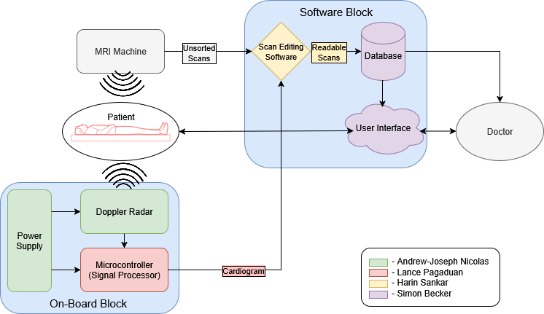
Contactless Cardiac Gating
Notes:
Eric

Slide 4
Project Timeline
Subsystem Designs and Testing (completed 2/2) | PCB Ordered (completed 2/4) | MCU and PCB Integration (to complete by 2/23) | Integration of Scan Filter and Desktop Application (to complete by 2/23) | System Testing (to complete by 3/11) | Validation (to complete by 4/6) | Demo and Report (to complete by 4/19)
Notes:
Eric

Slide 5
Radar/MCU Integration Lance Pagaduan
Accomplishments since last update 8 hrs of effort | Ongoing progress/problems and plans until the next presentation
Functional radar able to detect heartbeat and respiration rate from a 2m range. | On-going functional testing of the radar adjusting configuration parameters. Accurate I/Q data to be tested with MCU

Slide 6
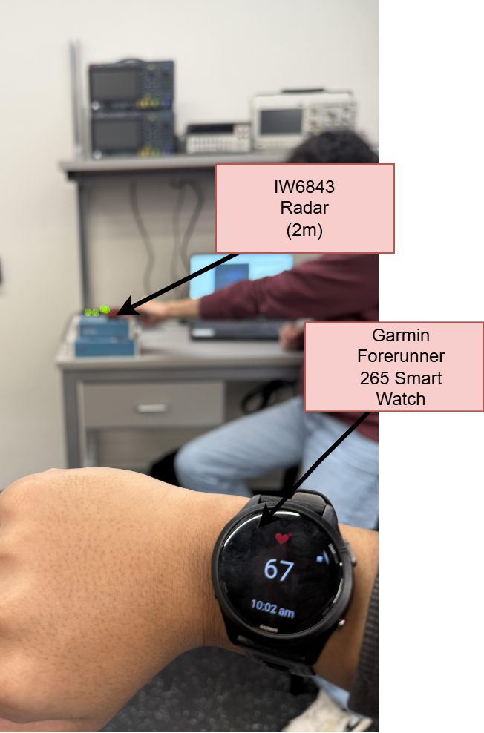
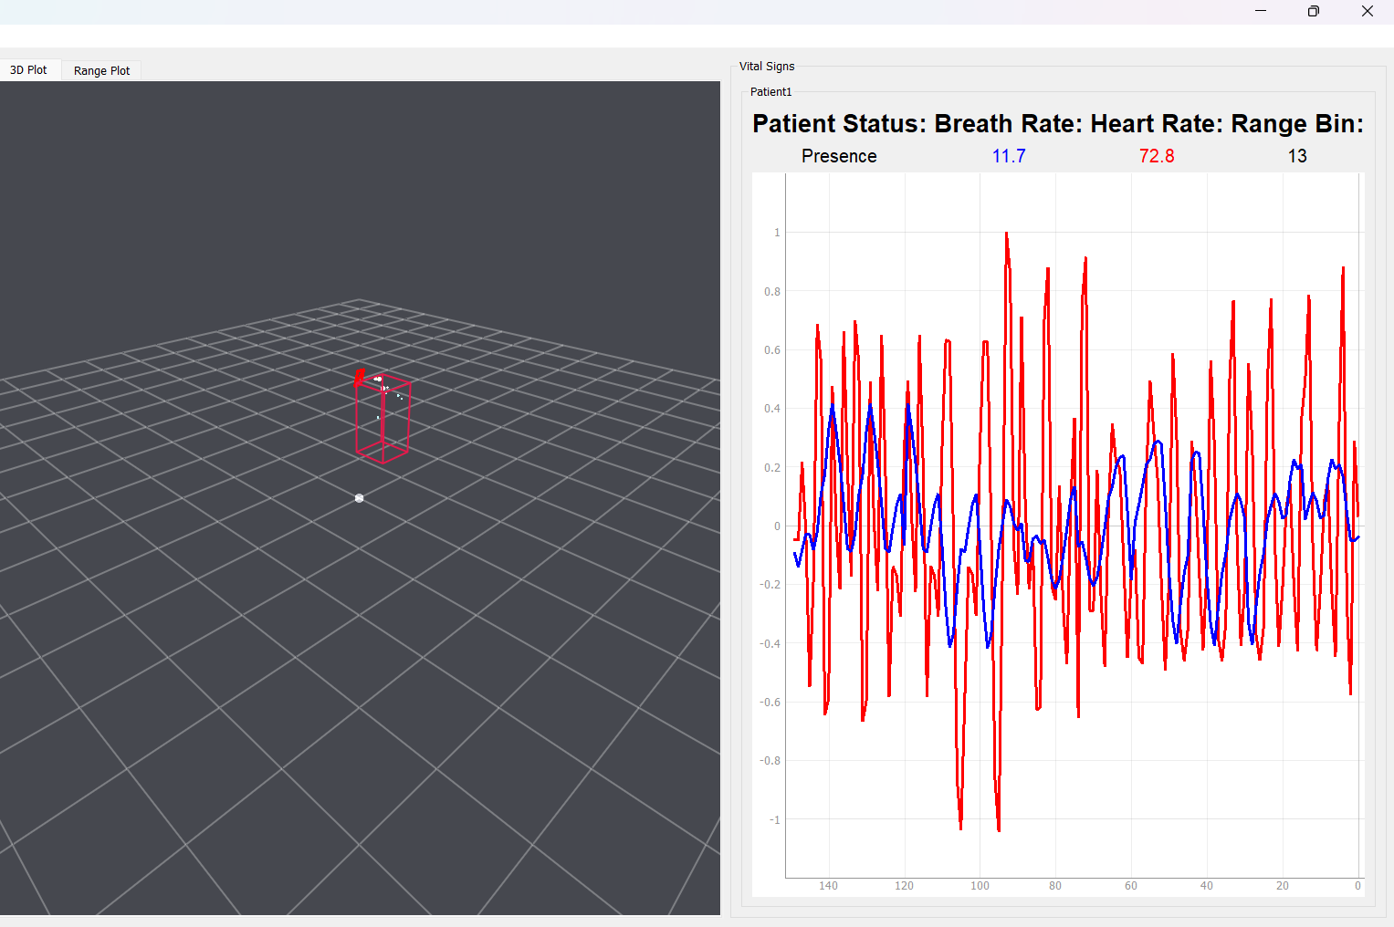
Radar/MCU Testing
Lance Pagaduan
Functional Testing Heart Rate 2 meters away

Slide 7
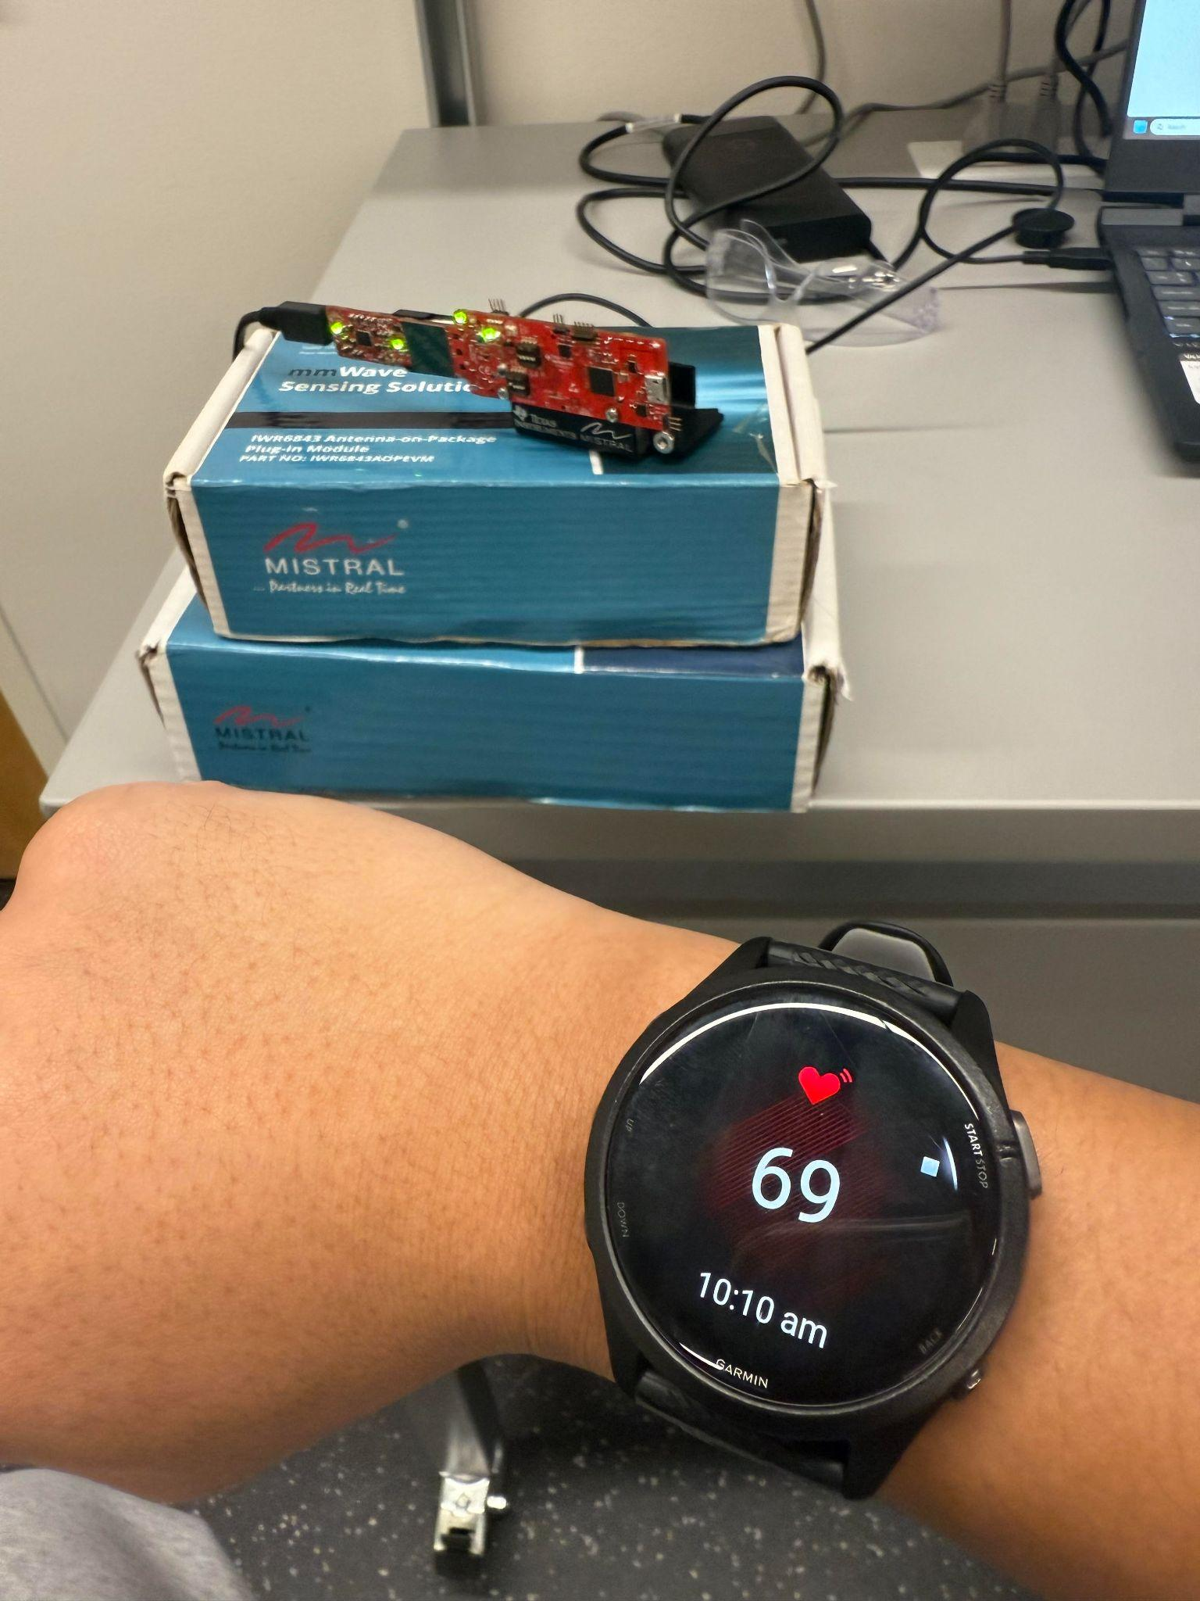
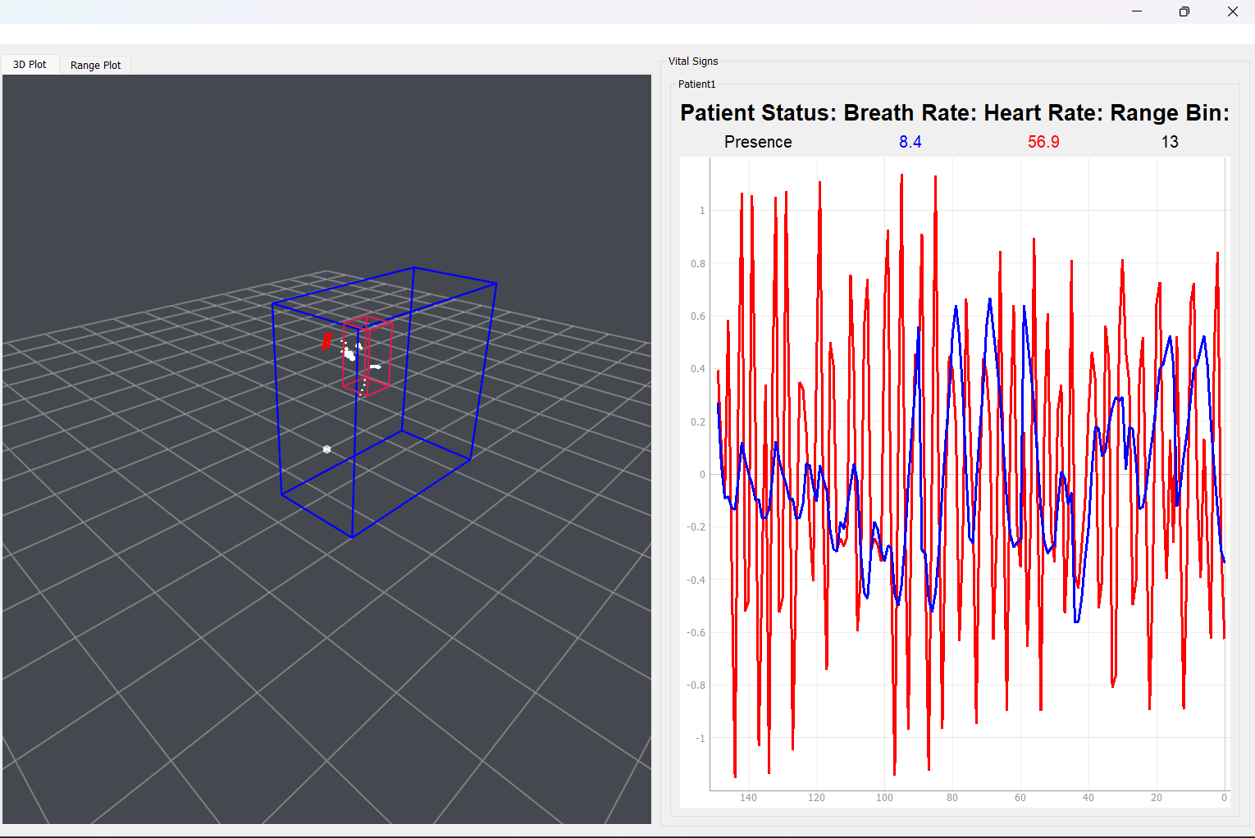
Radar/MCU Testing
Lance Pagaduan
Functional Testing Heart Rate Close Up

Slide 8
PCB Andrew Nicolas
Accomplishments since last update 8 hrs of effort | Ongoing progress/problems and plans until the next presentation
All parts have arrived as of 02/17. | Soldering parts onto PCB and validating essential integration between PCB and hardware. Improve accuracy of radar’s outputs.

Slide 9

CFG File Changes
Reducing the frame time can make heart rate updates smoother and less jumpy.
Shrinking the range window to focus only on the person’s chest can reduce sudden heart rate swings.
Isolating the detection area to the individual’s chest can reduce interference from background objects.

Slide 10
Testbench Design
Establish baseline metrics: average heart rate and respiration rate
Vary one physical parameter at a time (distance, angle, posture)
Vary one config parameter at a time (range-bin window, frame timing, detection boundary)
Compare each change against baseline using heart rate stability and bin switching as performance criteria

Slide 11
Scan Filter Harin Sankar
Accomplishments since last update 18 hrs of effort | Ongoing progress/problems and plans until the next presentation
MRI Integration: Selected MR Solutions + ISMRMRD/HDF5 path. Built and validated Python MR Solutions raw-data reader for instantaneous input. UI Integration: Set up environment where C# can call Python | MRI Integration: Add derived timestamps to MRI readouts based on MRI. Test multiple images/readouts against time for binning. UI Integration: Make C# environment retrieve a DICOM file from python code.

Slide 12
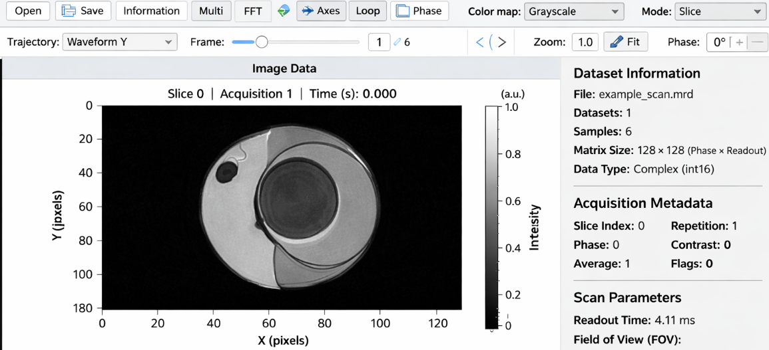
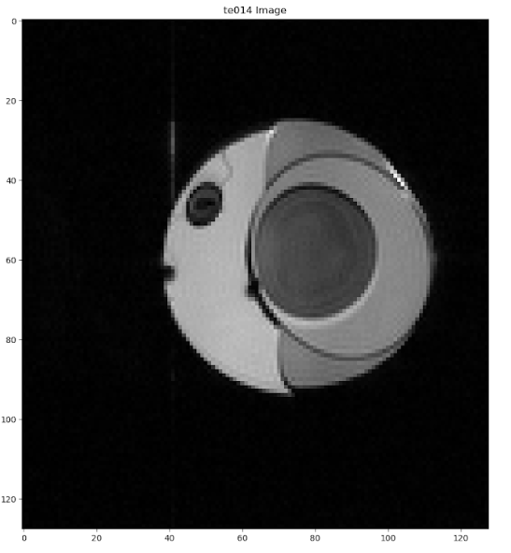
Scan Filter Harin Sankar
Expected Image
Generated Image

Slide 13
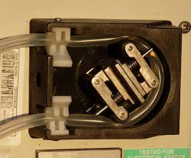
Scan Filter Harin Sankar
Testing Issues
MRI magnet planned shutdown in ~1 month (testing window is limited).
May need cryogen funding to keep the magnet running longer.
Testing plan: peristaltic pump + tubing near/inside a fluid-filled balloon to create repeatable motion for gating.

Slide 14
User Interface Simon Becker
Accomplishments since last update 16 hrs of effort | Ongoing progress/problems and plans until the next presentation
Written test bench code to verify Python.NET functionality | Testing and debugging of Python code in new C# environment Implementing this new environment with Scan Filter code

Slide 15
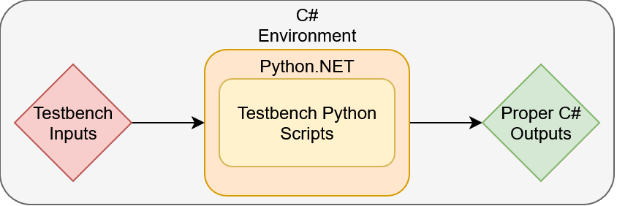
User Interface Simon Becker
Testbench ensures that Python.NET wrapper is functioning properly
Instead of stdout strings, Python.NET allows us to work entirely in C# objects

Slide 16
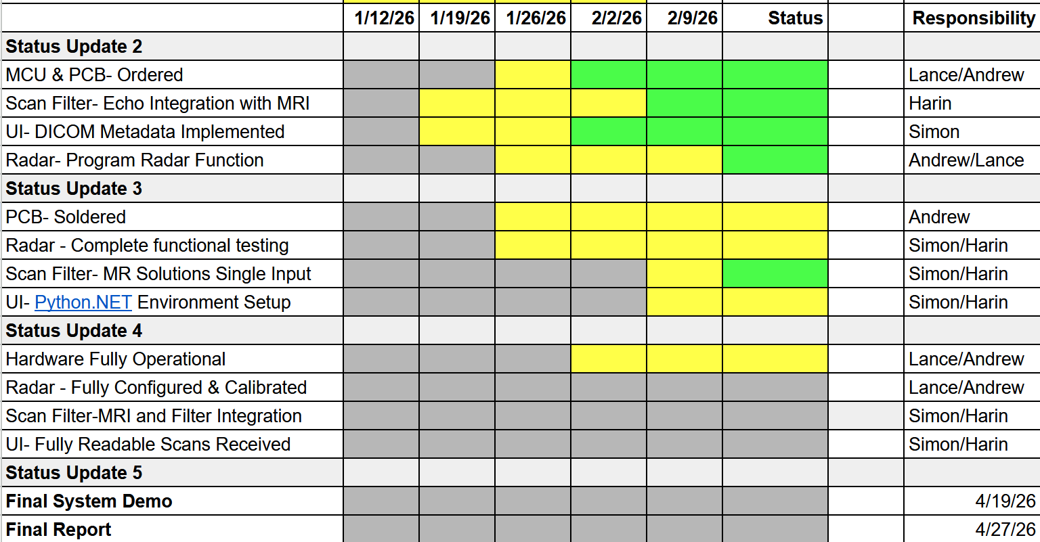
Execution & Validation Plan
Notes:
Michelle

Slide 17
Thank you!

